Slide 1


NEXT GEN EMPLOYABILITY PROGRAM
CREATING A FUTURE-READY WORKFORCE
Student Name :
Abhay Kumar
Student ID :
College Name :
STU61a6120b2b4f51638273547
Government PG College Dharamsala

Slide 2
CAPSTONE PROJECT SHOWCASE
Project Title
News Aggregator using Django Framework
Abstract | Problem Statement | Project Overview | Proposed Solution | Technology Used | Modelling & Results | Conclusion | Q&A

Slide 3
Abstract
1
“News Aggregator using Django Framework" aims to develop a dynamic web application for aggregating news articles.
2
The application will employ web scraping techniques using Beautiful Soup Python library to fetch real-time news updates, ensuring users stay informed about current events across various topics.
3
Leveraging Django's MVC architecture and ORM, the project aims to organize and present news content from diverse sources in a unified platform.
4
Incorporation of a user-friendly interface design, focusing on intuitive navigation and readability to enhance the overall user experience.

Slide 4


Problem Statement
The news aggregator project aims to create a centralized platform that curates and organizes news articles and updates from various sources across the internet using Python Django Framework. It is being developed to address the growing need for a consolidated and user-friendly platform that offers reliable and diverse news content.

Slide 5

Project Overview
Build a News Aggregator App using Python Language and Django Framework.
Used python libraries like Beautifulsoup to Scrape news from website
“ www.theonion.com ”.

Slide 6
Proposed Solution
Developed a Custom News Aggregator App utilizing Python Language and Django Framework.
Implemented Python libraries such as Beautifulsoup for scraping news from the Onion news website across various genres including Entertainment, Sports, Politics, Opinion, Breaking News.
Designed and integrated a custom modern-style navbar along with a theme-changing option for the site, enhancing user experience and aesthetic appeal.

Slide 7
Technology used
Backend: Python, Django framework
Frontend: HTML, CSS, JavaScript Database: SQLite
Web Scraping: BeautifulSoup
Website that we scrap: “www.theonion.com”

Slide 8
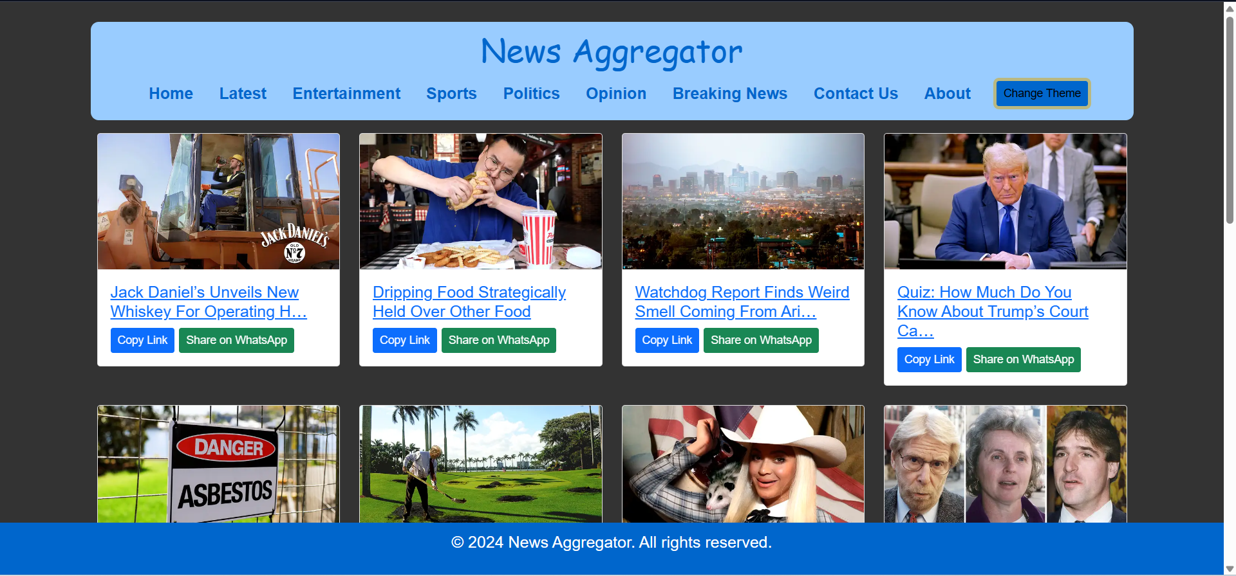
Modelling & Result

Slide 9
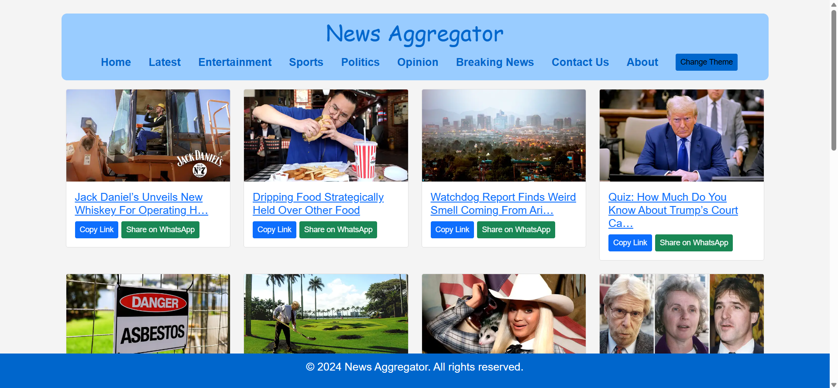
Modelling & Result

Slide 10
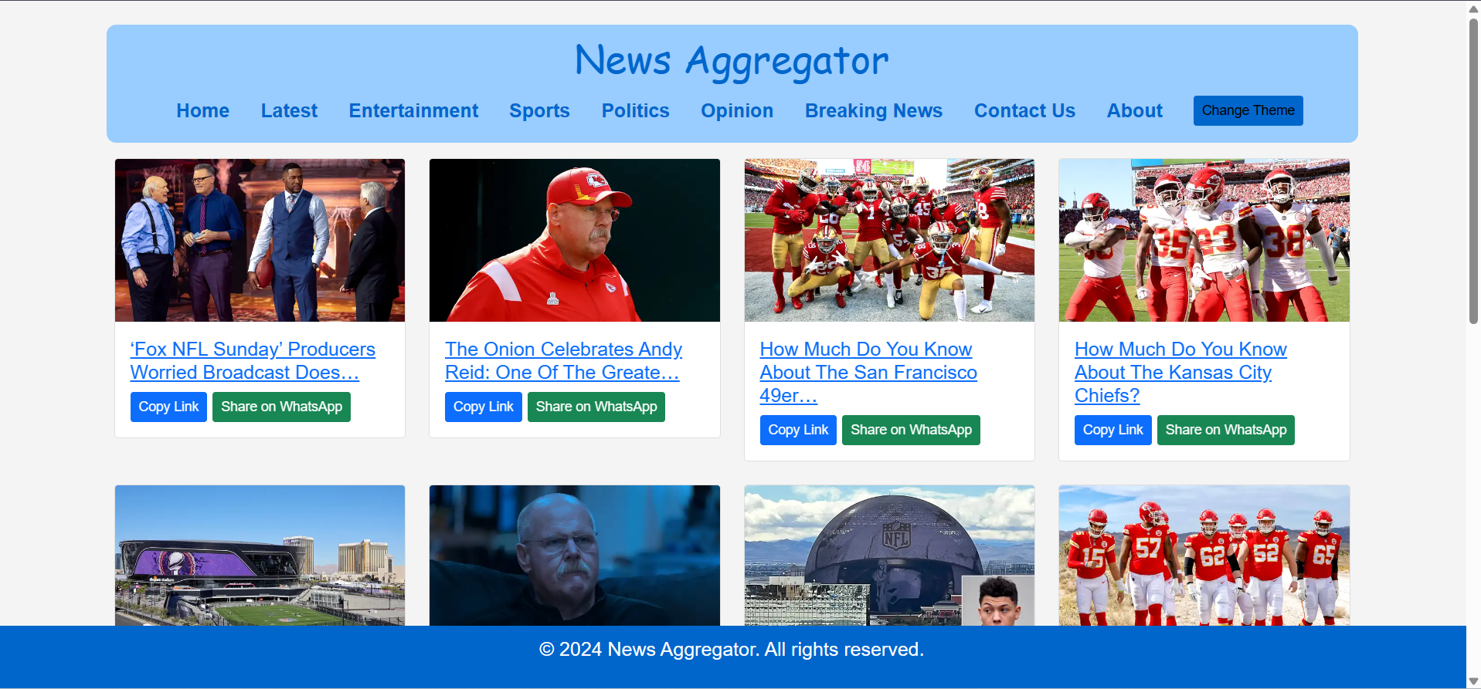
Modelling & Result

Slide 11
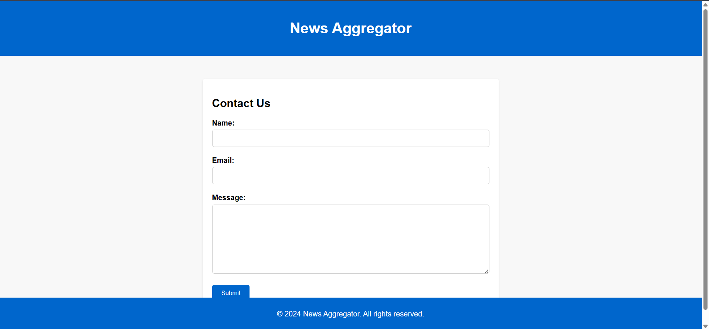
Modelling & Result

Slide 12

Conclusion
Successfully develop a Custom News Aggregator App using Python Django Framework.
Future plans include extending the web-app's capabilities by introducing a search bar alongside the news page for searching news articles.
Additionally, the app will be upgraded to aggregate news from multiple sources beyond the Onion site, broadening its coverage and utility.

Slide 13


Notes:
Thank You !!

